Slide 1

Capstone Project- 1
EDA on Airbnb bookings
Team Members Arunteja Lonka Abriti nanda Upasana Kumari

Slide 2








Introduction
Problem statement & Key objectives we are focusing on
Importing Python libraries & Stage setup
Data Preparation & Data Wrangling
Data visualisation using Python & Finding solutions
Analysing data using Tableau & Excel Dashboards
Challenges Faced
Results & Conclusions

Slide 3

Introduction to Airbnb
Airbnb, Inc. is an American company that operates an online marketplace for lodging, primarily homestays for vacation rentals, and tourism activities. Based in San Francisco, California, the platform is accessible via website and mobile app. Airbnb does not own any of the listed properties; instead, it profits by receiving commission from each booking. The company was founded in 2008 by Brian Chesky, Nathan Blecharczyk and Joe Gebbia. Airbnb is a shortened version of its original name, AirBedandBreakfast.com.

Slide 4
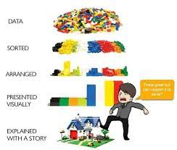
Introduction to Exploratory Data Analysis
Exploratory Data Analysis (EDA) is the process of visualizing and analysing data to extract insights from it. In other words, EDA is the process of summarizing important characteristics of data in order to gain better understanding of the dataset.
EDA is very essential because it is a good practice to first understand the problem statement and the various relationships between the data features before getting your hands dirty.
Understanding EDA
To understand the steps involved in EDA, we will use Python as the programming language and Jupyter Notebooks because it’s open-source, and not only it’s an excellent IDE but also very good for visualization and presentation.
Technically, The primary motive of EDA is to
Examine the data distribution
Handling missing values of the dataset(a most common issue with every dataset)
Handling the outliers
Removing duplicate data
Encoding the categorical variables
Normalizing and Scaling

Slide 5

Problem statement ..
Since 2008, guests and hosts have used Airbnb to expand on traveling possibilities and present a more unique, personalized way of experiencing the world. Today, Airbnb became one of a kind service that is used and recognized by the whole world. Data analysis on millions of listings provided through Airbnb is a crucial factor for the company. These millions of listings generate a lot of data - data that can be analysed and used for security, business decisions, understanding of customers' and providers' (hosts) behaviour and performance on the platform, guiding marketing initiatives, implementation of innovative additional services and much more.
This dataset has around 49,000 observations in it with 16 columns and it is a mix between categorical and numeric values.
Our main objective is to find out the key metrics that influence the listing of properties on the platform.
We will be find out the distribution of every Airbnb listing based on their locations , Including their Price range ,room type, listing name and other related factors

Slide 6

Key objectives we are focusing on…
We are focusing on the following questions to analyses the Airbnb booking:
What is the average preferred location & Price range?
Number of active hosts per location?
Room type and their relation with availability in different neighbourhood groups?
What can we learn about different hosts and areas?
What can we learn from predictions? (ex: locations, prices, reviews, etc)
Which hosts are the busiest and why?
Is there any noticeable difference of traffic among different areas and what could be the reason for it?
Understanding the Customer behaviour?

Slide 7
Importing Python libraries & Stage setup
A Python library is a collection of related modules. It contains bundles of code that can be used repeatedly in different programs. It makes Python Programming simpler and convenient for the programmer.
Python have more than 137,000 libraries, Python can be used to create applications and models in a variety of fields, for instance, machine learning, data science, data visualization, image and data manipulation, and many more…
In this Project we are mainly Using some libraries..(i.e., NumPy , Pandas , matplotlib , seaborn, etc..)
After importing libraries we will come up with an imaginary story to explain the data
Data visualization also helps to tell stories by curating data into a form easier to understand, highlighting the trends and outliers.
A good visualization tells a story, removing the noise from data and highlighting the useful information.
Good visualization combined with daily life stories/any well known frictional characters ,they can impact more and we will understand simply and remembering easily ..

Slide 8
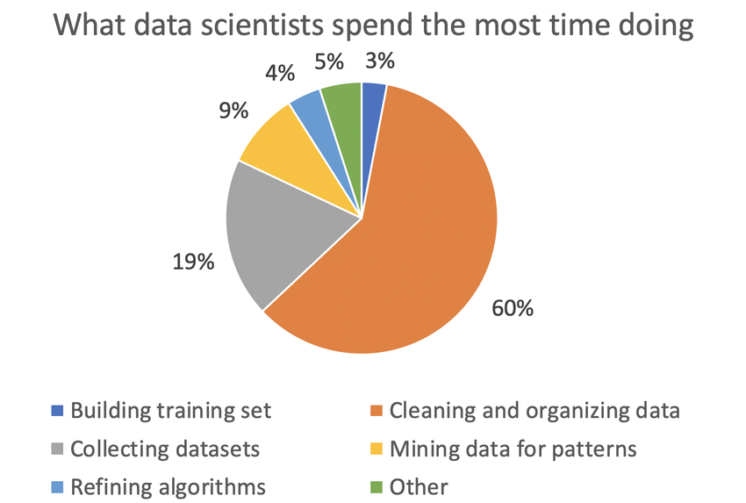
Data Preparation & Data Wrangling
Data pre-processing is an important task. It is a data mining technique that transforms raw data into a more understandable, useful and efficient format.
Data has a better idea. This idea will be clearer and understandable after performing data pre-processing.
The data cleaning process detects and removes the errors and inconsistencies present in the data and improves its quality. Data quality problems occur due to misspellings during data entry, missing values or any other invalid data.
Basically, “dirty” data is transformed into clean data. “Dirty” data does not produce the accurate and good results. Garbage data gives garbage out. So it becomes very important to handle this data. Professionals spend a lot of their time on this step.
What to do to clean data?
Handle Missing Values
Handle Noise and Outliers
Remove Unwanted data

Slide 9
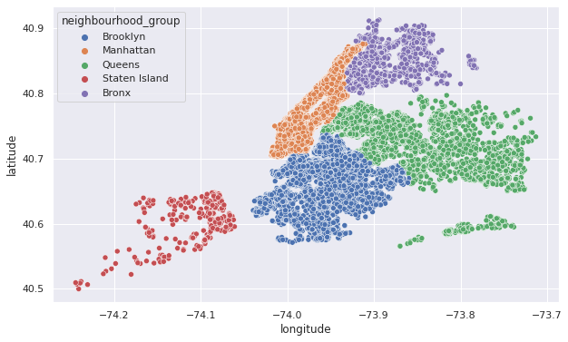
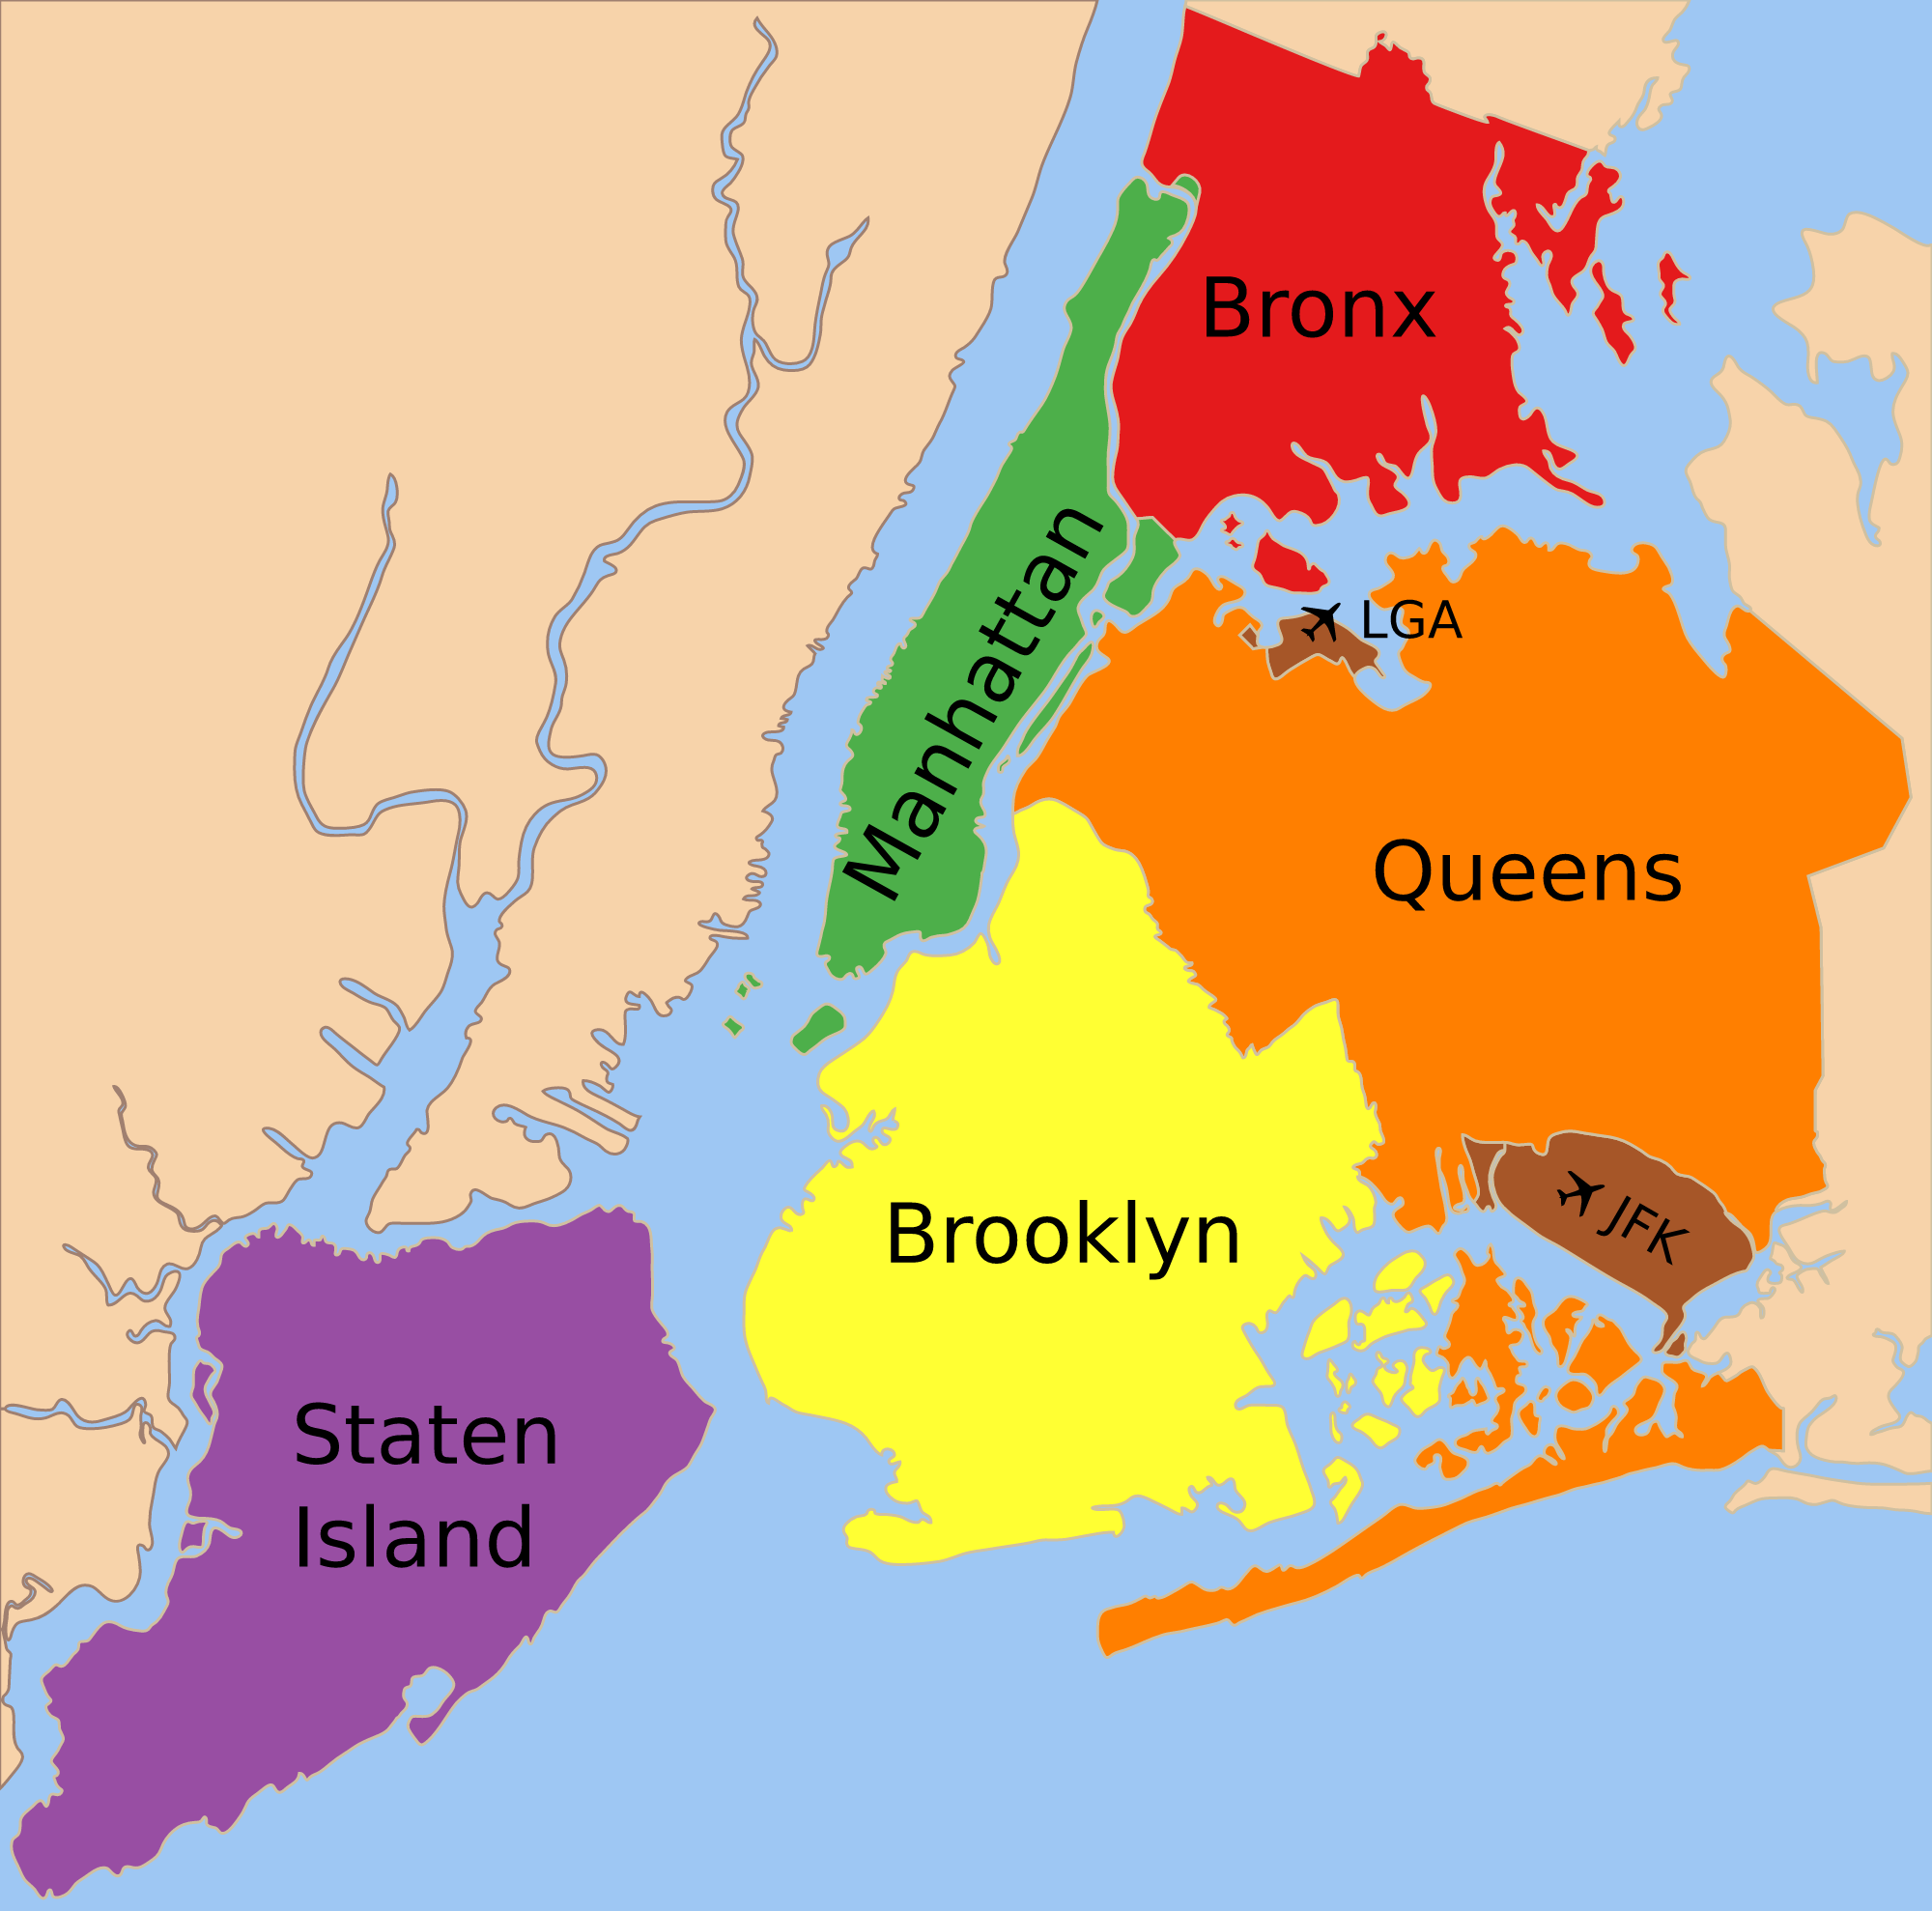
Map of New York city (NYC)

Slide 10
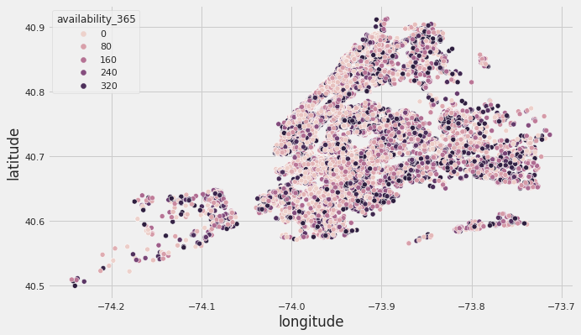
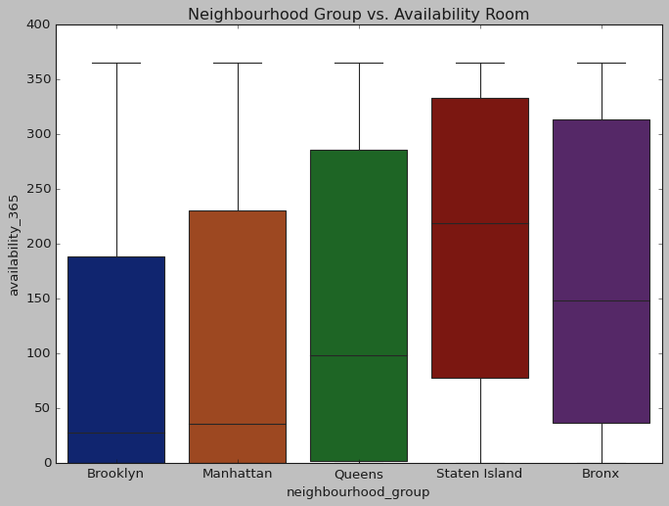
Neighbourhood Group vs. Availability of Room

Slide 11
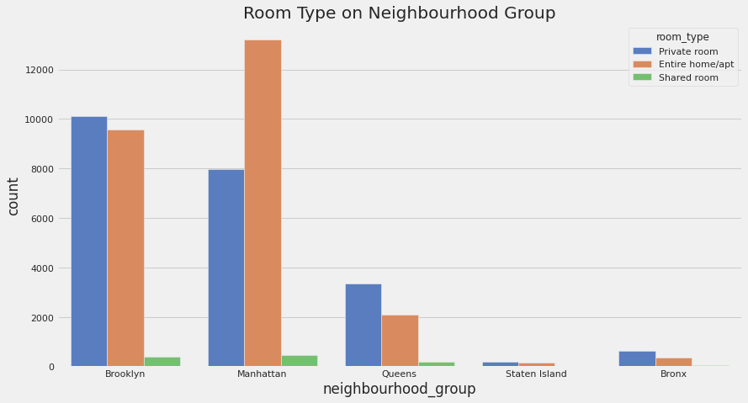
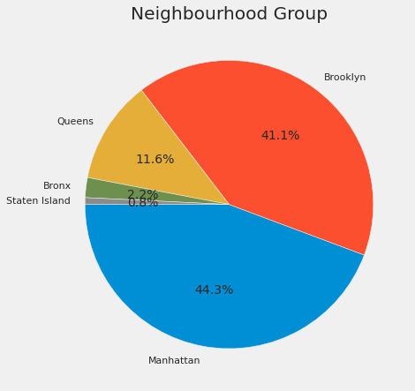
Number of Airbnb listings v/s Neighbourhood Group & Type of Rooms Present
The graph shows that the Entire Home/Apartment is listed most near Manhattan, while Private Rooms and Apartments Near Brooklyn are Nearly equal.

Slide 12
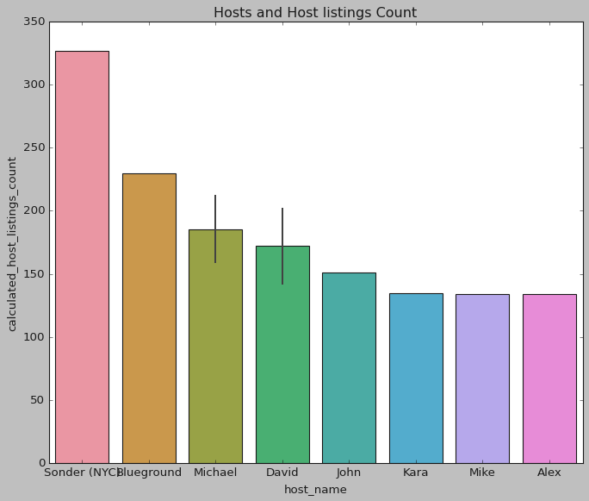
What can we learn about different hosts and areas?
Here are some interesting findings, we found fascinating:
8 out of top 10 hosts are from the ''Manhattan'' neighbourhood group.
2 out of top 10 hosts are from the ''Brooklyn" neighbourhood group.
[ Sonder (NYC), Blueground, Michael, David, John, Kara, Alex, Mike] are the top hosts of Manhattan neighbourhood group.
[ Michael , David] are the top hosts in Brooklyn neighbourhood group.
Manhattan neighbourhood group hosts are out-performing in listings.
host_name , neighbourhood_group , calculated_host_listings_cout
13216 Sonder (NYC) Manhattan 327
1833 Blueground Manhattan 230
9741 Michael Manhattan 212
3249 David Manhattan 202
9740 Michael Brooklyn 159
6807 John Manhattan 151
3248 David Brooklyn 142
7274 Kara Manhattan 135
9855 Mike Manhattan 134
431 Alex Manhattan 134

Slide 13
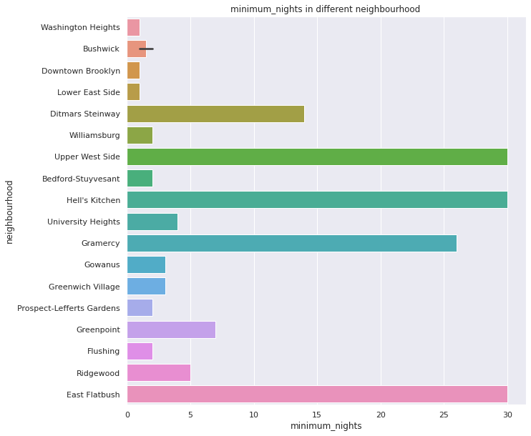
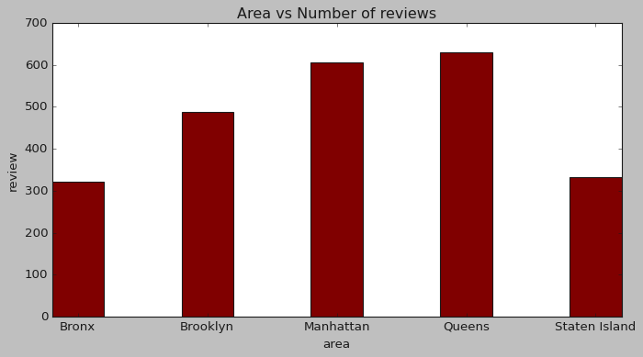
What can we learn from predictions? (ex: locations, prices, reviews, etc)

Slide 14
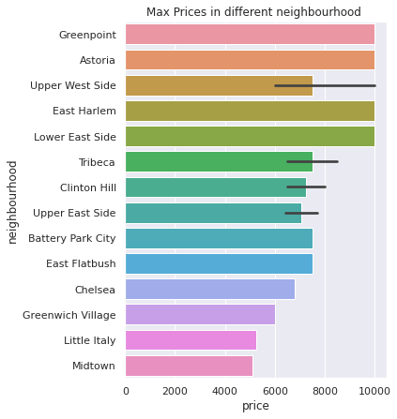
What can we learn from predictions? (ex: locations, prices, reviews, etc)

Slide 15
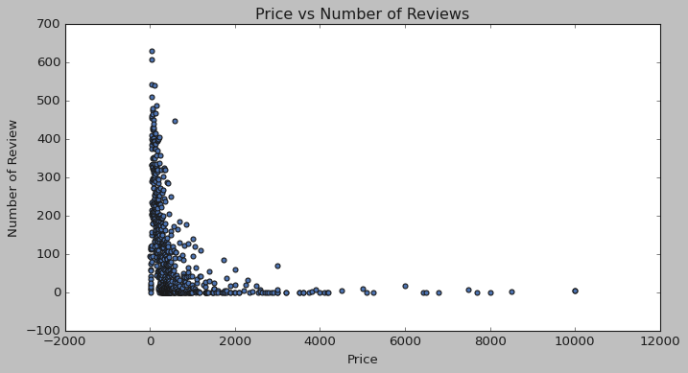
What can we learn from predictions? (ex: locations, prices, reviews, etc)
Price v/s Number of Review

Slide 16
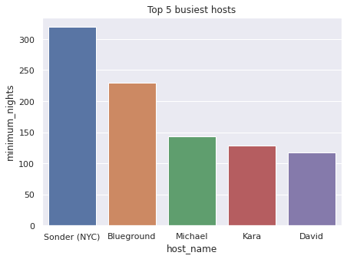
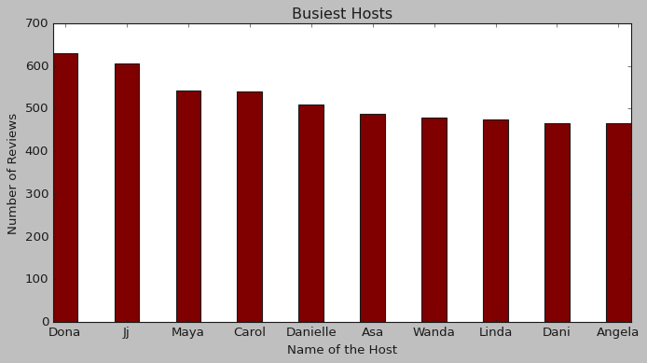
Which hosts are the busiest and why?
Because these hosts listed room type as Entire home and Private room which is preferred by most number of people.

Slide 17
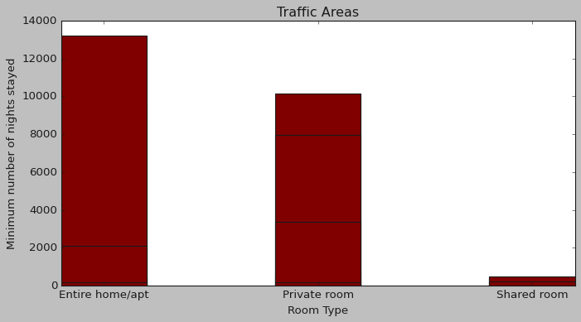
Is there any noticeable difference of traffic among different areas and what could be the reason for it?
The people who prefer to stay in Entire home or Apartment they are going to stay bit longer in that particular Neighbourhood only.
Most people prefer to pay less price.
If people are not staying more then one night means they are travellers.
Tourist places with less price Entire home or Apartment and Private rooms have more traffic .

Slide 18
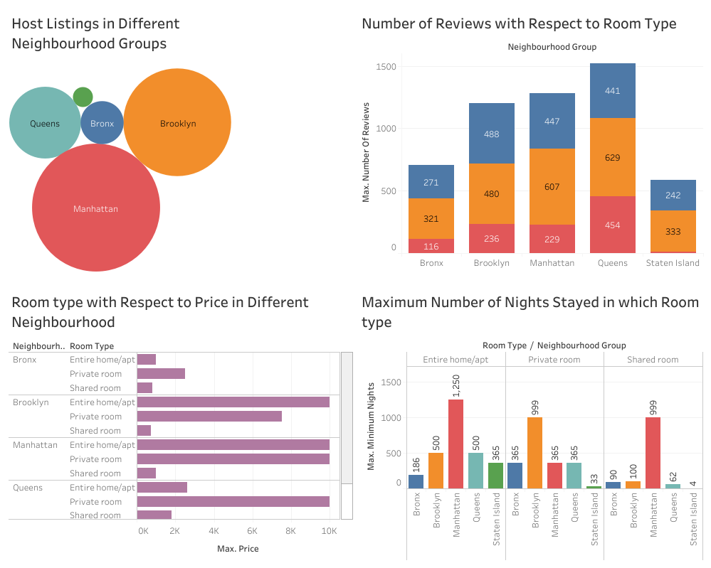
Analysing data using Tableau Dashboards

Slide 19
Analysing data using Excel

Slide 20
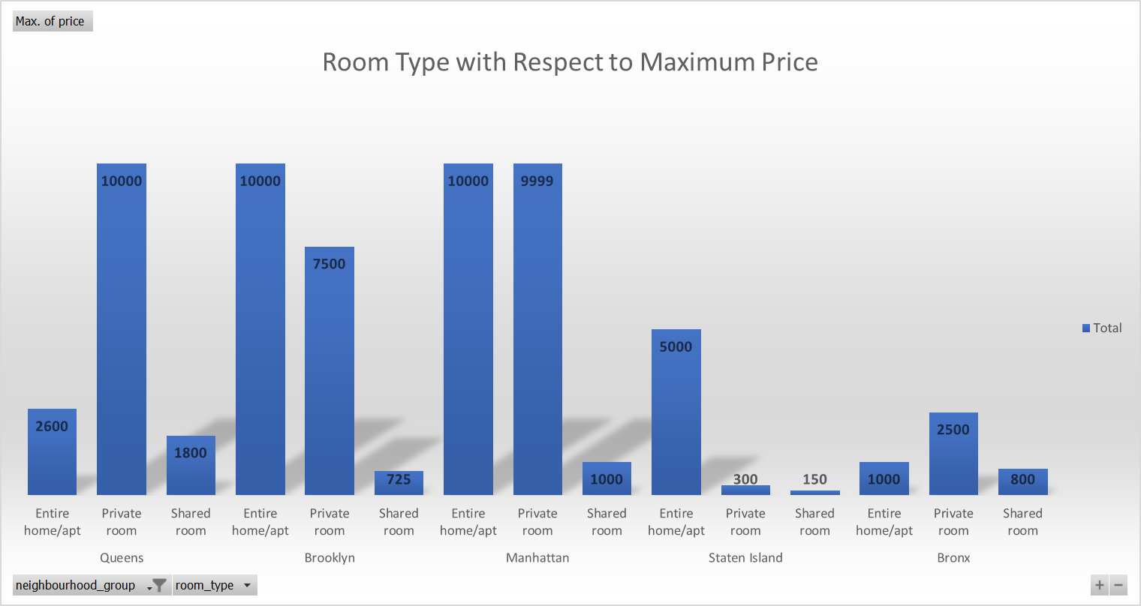
Analysing data using Excel Dashboards
Neighbourhood Group / Room Type | Max. of price
Queens | 10000
Entire home/apt | 2600
Private room | 10000
Shared room | 1800
Brooklyn | 10000
Entire home/apt | 10000
Private room | 7500
Shared room | 725
Manhattan | 10000
Entire home/apt | 10000
Private room | 9999
Shared room | 1000
Staten Island | 5000
Entire home/apt | 5000
Private room | 300
Shared room | 150
Bronx | 2500
Entire home/apt | 1000
Private room | 2500
Shared room | 800
Grand Total | 10000

Slide 21
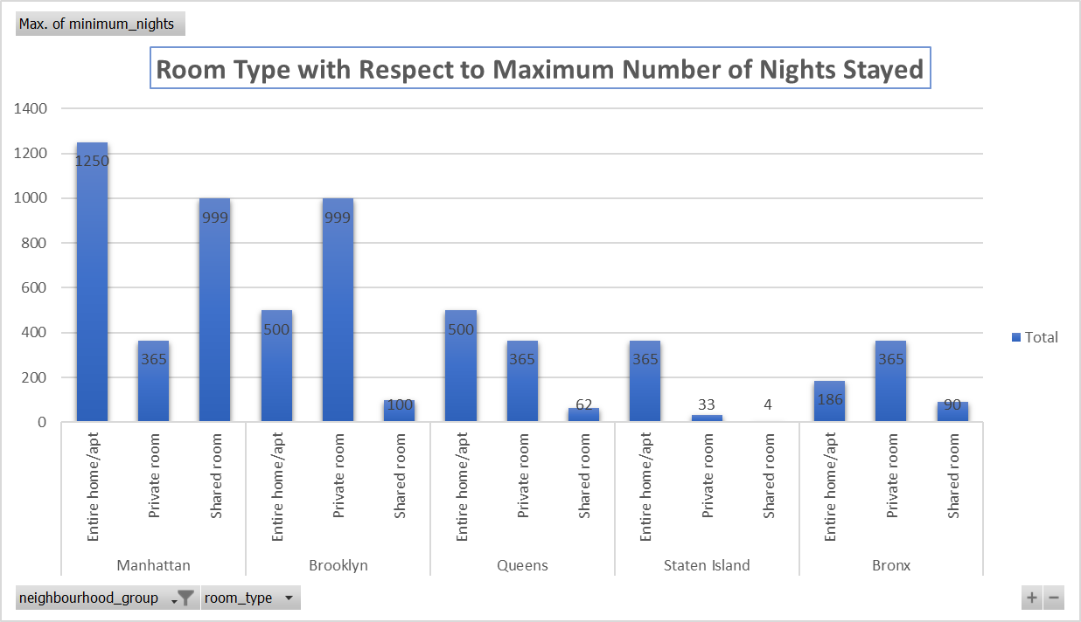
Analysing data using Excel Dashboards
Neighbourhood Group / Room Type | Max. of minimum_nights
Manhattan | 1250
Entire home/apt | 1250
Private room | 365
Shared room | 999
Brooklyn | 999
Entire home/apt | 500
Private room | 999
Shared room | 100
Queens | 500
Entire home/apt | 500
Private room | 365
Shared room | 62
Staten Island | 365
Entire home/apt | 365
Private room | 33
Shared room | 4
Bronx | 365
Entire home/apt | 186
Private room | 365
Shared room | 90
Grand Total | 1250

Slide 22

Results & Conclusions:
The people who prefer to stay in Entire home or Apartment they are going to stay bit longer in that particular Neighbourhood only.
The people who prefer to stay in Private room they won't stay longer as compared to Home or Apartment.
Most people prefer to pay less price.
If there are more number of Reviews for particular Neighbourhood group that means that place is a tourist place.
If people are not staying more then one night means they are travellers.
we proceeded with analysing boroughs and neighbourhood listing densities and what areas were more popular than another.
From the entire analysis on Airbnb bookings analysis , Our assumptions before analysis went totally different after getting results from the analysis.

Slide 23


Challenges Faced
Understanding Problem Statement
Reading the dataset and Understanding the meaning of some columns
For Answering some questions we had to understand the business model of Airbnb & Geograpy of New York city
Handling NaN values and duplicates
Designing multiple visualisations to summarize the information in the dataset and successfully communicate the results and trends to clints/readers

Slide 24

Summary
Airbnb dataset-2019 appeared to be a very rich dataset with a variety of columns that allowed us to do deep data exploration on each significant column presented.
First, we have found hosts that take good advantage of the Airbnb platform and provide the most listings; we found that our top host has 327 listings.
After that, we proceeded with analysing boroughs and neighbourhood listing densities and what areas were more popular than another.
From the entire analysis on Airbnb bookings analysis , Our assumptions before analysis went totally different after getting results from the analysis.
The whole EDA process gave very fascinating results and insights that will be helpful for business development and expansion, budget allocations and focussing on things people prefer. Italicized text

Slide 25

Refences and links
Greeks for greeks
analytics Vidhya
Stack overflow
Airbnb official site
Google maps
Quora
Git hub link:
Google Drive link:
Google colab link:

